Slide 1
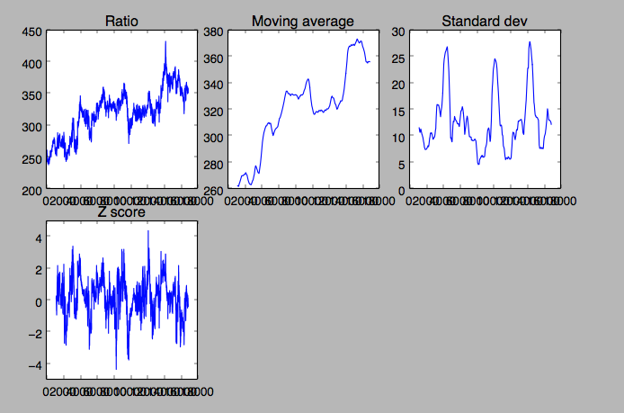
ARK BCHH18

Slide 2
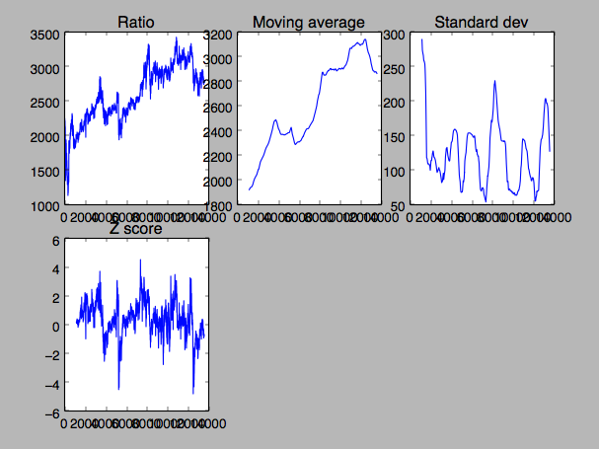
BLZ BCHH18

Slide 3
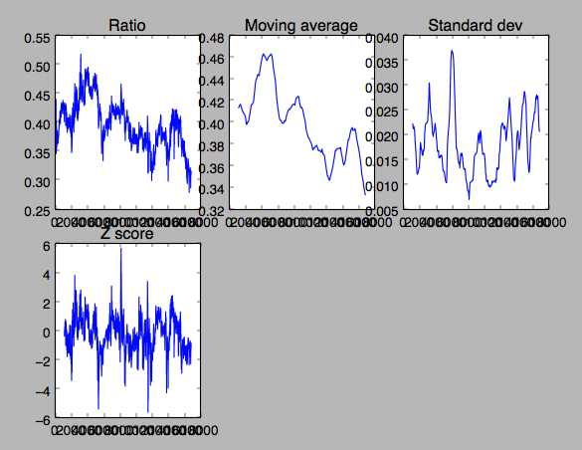
BRD ADAH18

Slide 4
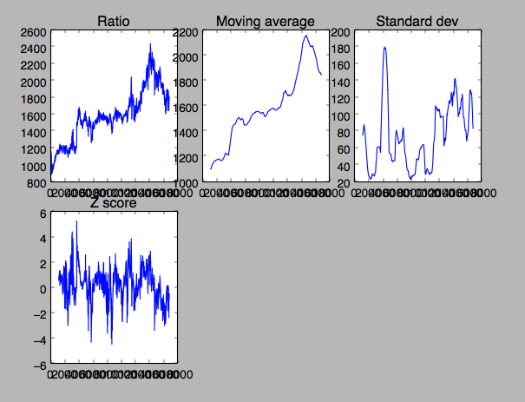
BRD BCHH18

Slide 5
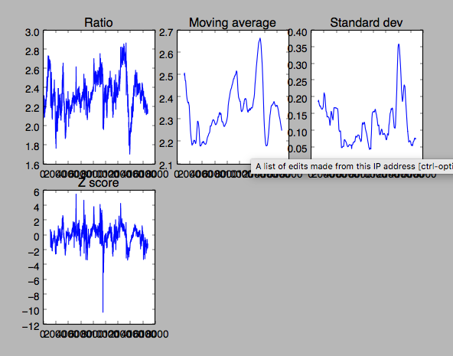
CND ADAH18

Slide 6
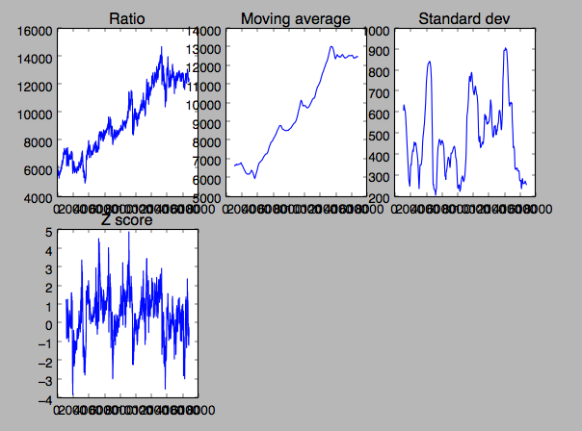
CND BCHH18

Slide 7
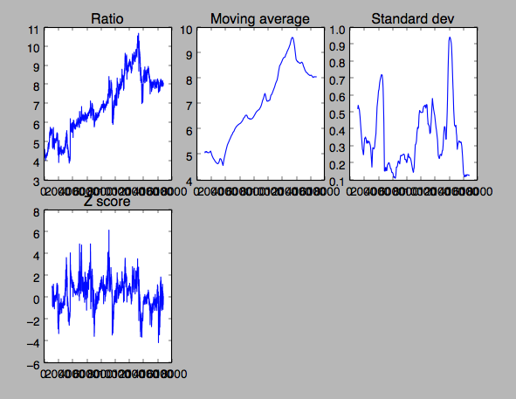
CND XRPH18

Slide 8
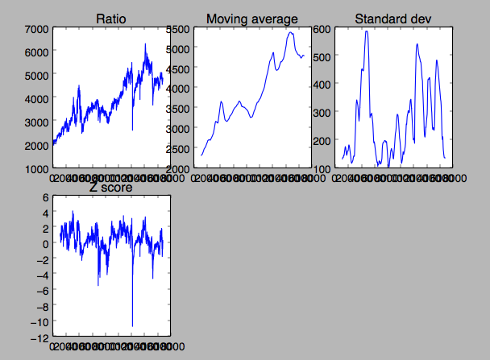
DLT BCHH18

Slide 9
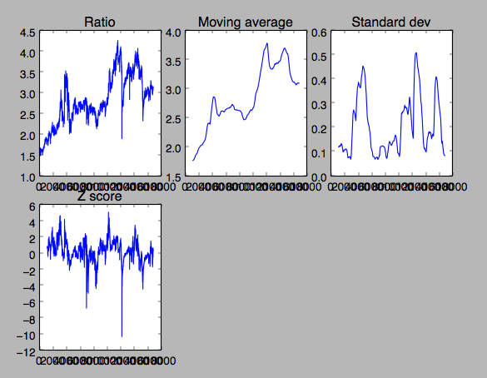
DLT XRPH18

Slide 10
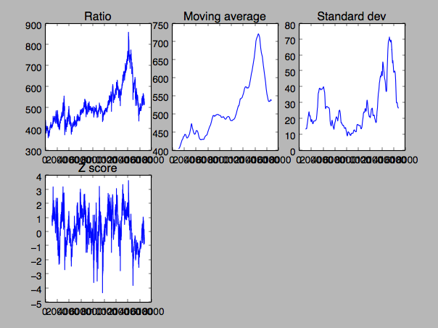
ENG BCHH18

Slide 11
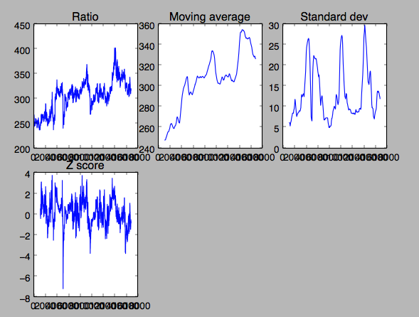
KMD BCHH18

Slide 12
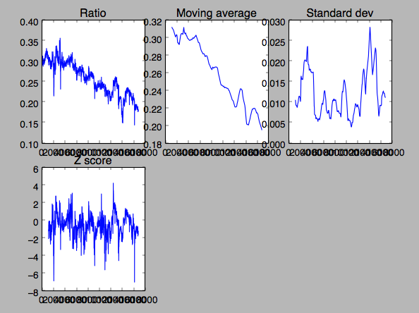
MDA ADAH18

Slide 13
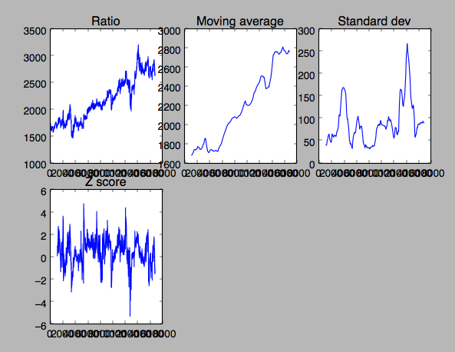
POWR BCHH18

Slide 14
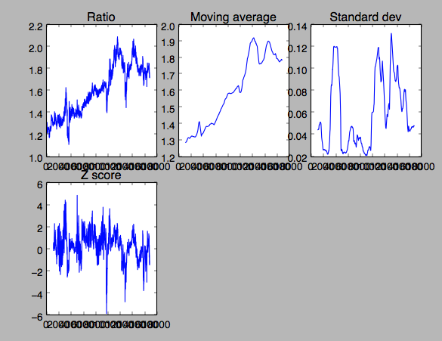
POWR XRPH18

Slide 15
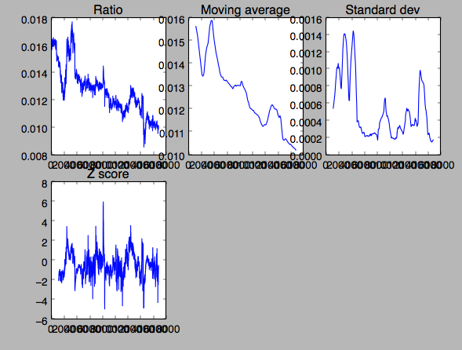
RCN BCHH18

Slide 16
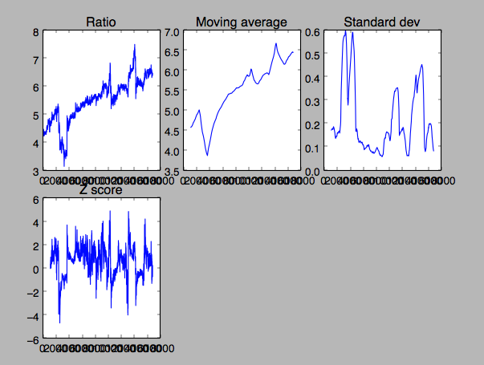
SNT XRPH18

Slide 17
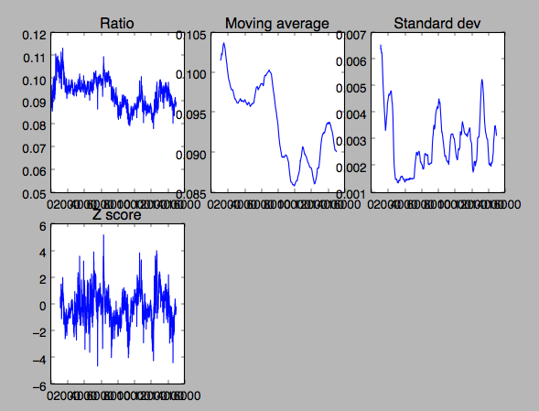
STEEM ADAH18

Slide 18
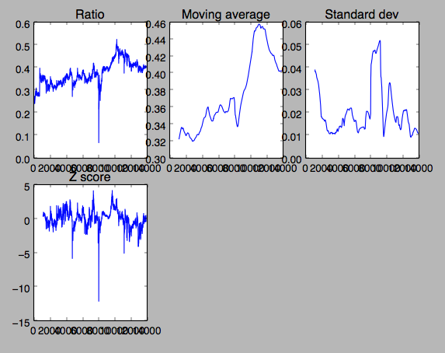
VIA XRPH18

Slide 19
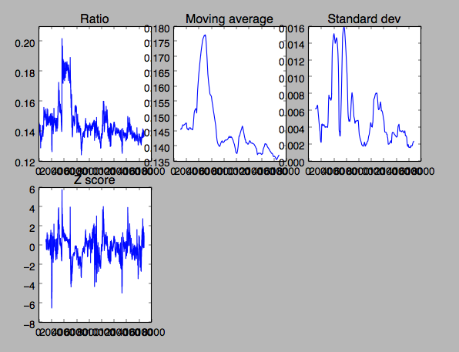
WAVES XRPH18

Slide 20
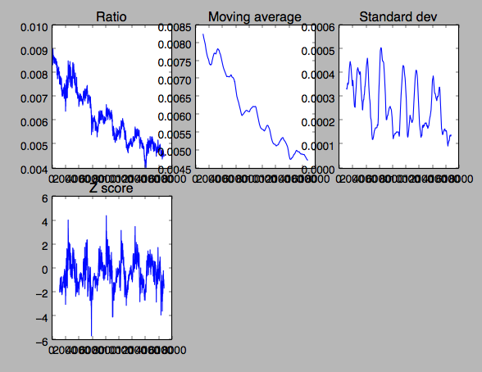
XZC ADAH18

